Slide 2
Resiliency Test with WireMock for Derivative Service
Christy Gu, Richard Su
SQA Manager, Sr. SQA Engineer
Notes:
Good afternoon everyone. It’s a pleasure to host this session and share our experience of resiliency test with you.
I’m Christy, I have been with Autodesk for 9 years. My first project in Autodesk was a search engine, and my role was an automation tester. From 2011, I joined cloud platform, and began to work for core services testing. Till today, my team is working on all kinds of testing for cloud services, including functional, load and performance, resiliency, security, and so on.
Here is my team mate Richard.
Good afternoon. I’m Richard. I have been a QA engineer in Autodesk for almost 10 years. In 2014 I joined Christy’s team. Since then I have tested ACM, OSS, RAAS, and Derivative Service.

Slide 3
Agenda
Resiliency Test Introduction
Resiliency Test Infrastructure
Resiliency Test Results Analysis
Notes:
In today’s session, I will firstly introduce what resiliency test is, why resiliency test is important, and gave you a real downgrade case to help you understand the concepts of resiliency test.
Then Richard will introduce the infrastructure we set up for Derivative Service resiliency test, and share real test results.
Finally, if you have any questions, we can discuss them in the Q&A session.

Slide 4
Resiliency Test Introduction

Slide 5
Cloud Services Test Area
USEFUL
SCALABLE
FUNCTIONAL TEST
LOGEVITY TEST
CLOUD SERVICES
STABLE
SECURE
SECURITY TEST
PERFORMANCE TEST
AVAILABLE
FAULT TOLERANT
RESILIENCY TEST
LOAD
TEST
Notes:
When we use cloud services, we have some expectations tothem. The service is expected to be useful for my scenarios. It need be scalable, when my usage load is increasing, the service need handle it. It has to be stable, and available, whenever I want to use it. It need be secure, so that I don’t worry about my data privacy. I can understand there are failures happen sometimes, but I hope the service is fault tolerant enough to handle those failures, and is still able to try it best to serve my request.
To verify and guarantee the services are able to meet those expectations, we provide a lot of testing. For example, functional testing guarantee the usage is expected, longevity, performance, load, test verifies the services’ stability, availability and scalability. And resiliency test evaluate how the service is fault tolerant.

Slide 6
What is Resiliency Test
Try its best to survive
Data should be consistent
FAULT TOLERANT
RESILIENCY TEST
CLOUD SERVICES
Failures happen any time
Network fail to connect
Dependencies fail to respond
Machines crash
Notes:
Looking at the infrastructure of cloud services, we find that failures may happen any time. Network may fail to connect sometimes, hardware may fail occasionally, machines may crash without notifications, dependent libraries and components may fail to respond. When ever such failure happens, whether the services can still survive without crash as a whole? Whether the services can recover when the failures are back to normal? Whether the data keep consistent when the services suffer some levels of failures? These points are all necessary evaluation area in resiliency test. So we say, resiliency test is a way to evaluate how a service perform when failures happen, and tries to improves a service’s resiliency.

Slide 7
Why is Resiliency Test Important
Fusion 360
BIM 360
A360
Forge
Oxygen/Apigee
Derivative Service
Authentication
CSE
Event
Web Service
Writing Service
Metering
ABus
Billing
ABus
DS Adapter
ZooKeeper
Kafka/Unified Logging
S3/OSS/ACM
Logging
Storage
Translation Service/Hydrogen/Workers
Translation
Notes:
Resiliency test is very important.
Let’s take a look at derivative service’s architecture. You will understand why I said it’s important.
The Derivative Service is a service for clients to get derivatives of any kind from design data for various purposes.
It has some important customers, such as Fusion 360, BIM 360, A360 and Forge, there are some others of course.
DS is not a stand alone service, it relies on many other systems to complete functional workflows. It relies Apigee and Oxygen for login and token validations, It relies on Abus and CSE to send events to other services, it stores derivatives to OSS or S3, and relies ACM to manage the access permissions, It leverages metering to calculate usage of apis, it depends on kafka and adp to streamline logs for further data analysis. Its key translation jobs are delivered to translation, hydrogen and extractors to do. So these services are all its external dependencies.
Internally, DS has four modules, web service is to handle web requests, writing service and ZooKeeper cluster is used to merge the manifest file, DS Adapter works with Abus to handle events.
From this architecture, we realize that DS has so many internal and external dependencies, if any of them is in bad shape, how DS will be impacted? Before we do the resiliency test, we really didn’t know the consequences. That’s why it’s important to know what will happen if any dependency is failing.

Slide 8
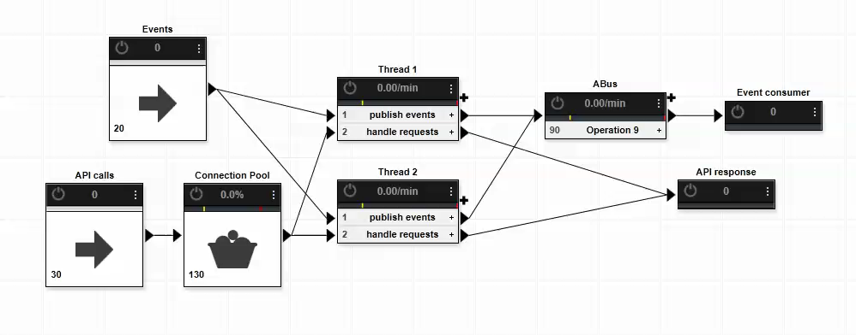
A Real Downgrade Case
Notes:
Someday we did know one consequence when Abus has real latency.
This is a real downgrade case we have ever suffered.
This concept animation shows how this downgrade happened. DS will send the events to Abus and Abus will respond OK when it receives and processes the event. This issue happened when Abus had long latency. DS service is unavailable after Abus has long latency for a while. The reason is we use the same thread pool to handle api requests and publish events. When Abus is slow, more and more threads will be used to publish events and finally all the threads are used, no threads to handle new api requests.

Slide 9
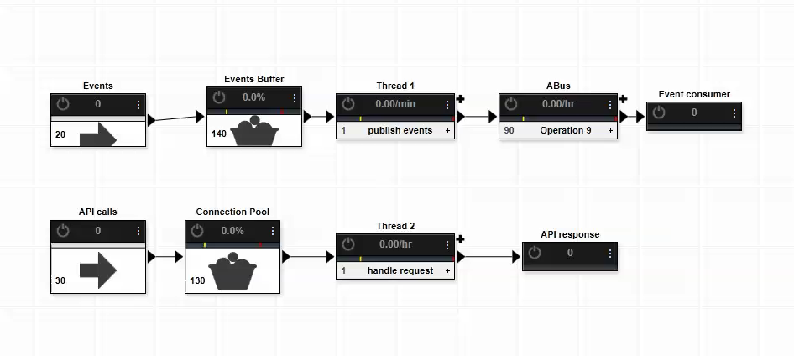
A Real Downgrade Case
Notes:
This is the improved solution to fix the issue. We decouple publishing events and handling api requests. Then when it’s slow to publish events, api requests will not be impacted. And we add a event buffer to handle the Abus unstable situation. When Abus has long latency, the events will be stored in the buffer and after Abus recovers , they could be published very soon. In the old solution, some events could be lost.

Slide 10
Resiliency Test Infrastructure
Notes:
I will firstly introduce the methodology of resiliency test
Then I will share how to use WireMock for resiliency test
And how to use Fabric to deploy servers
Finally I will talk about the Resiliency Test Scenarios and show you a Demo

Slide 11
Methodology
DS
OSS
Typical DS call to OSS
Build a mock service to slow down the requests.
Build a mock service to return errors directly.
DS
OSS
Mock Server
DS
OSS
Mock Server
Notes:
The purpose of resiliency test is to understand how good DS will behave when some of its dependent services respond error or have long latency. Take DS and OSS for example. Ds will put some files to OSS. We cannot really make OSS down because other services also rely on it. We know that in unit test we always try to mock some objects to simplify the test. So the idea is to create a service to mock the errors and slowness.
If we want to simulate OSS has long latency, we can let DS to connect to the mock server, and hold the request for a while and send to OSS.
And if we want to simulate OSS has errors, we just need to let DS to connect to the mock server and then respond the error to DS.
Then we can run the related test cases to check what will happen.

Slide 12
Methodology
Architecture and Code Analysis
Deploy Mock server
Run test cases
Deploy DS server
Notes:
There are four parts for DS resiliency test.
Firstly we need to understand DS infrastructure to start our test plan.
Then we need to create a DS service for test. By editing its configuration file, we can let DS server connect to mock server for some services.
Thirdly we need to deploy the mock service to handle the DS requests for some specific service.
Finally we need to trigger the automation test cases to test.

Slide 13
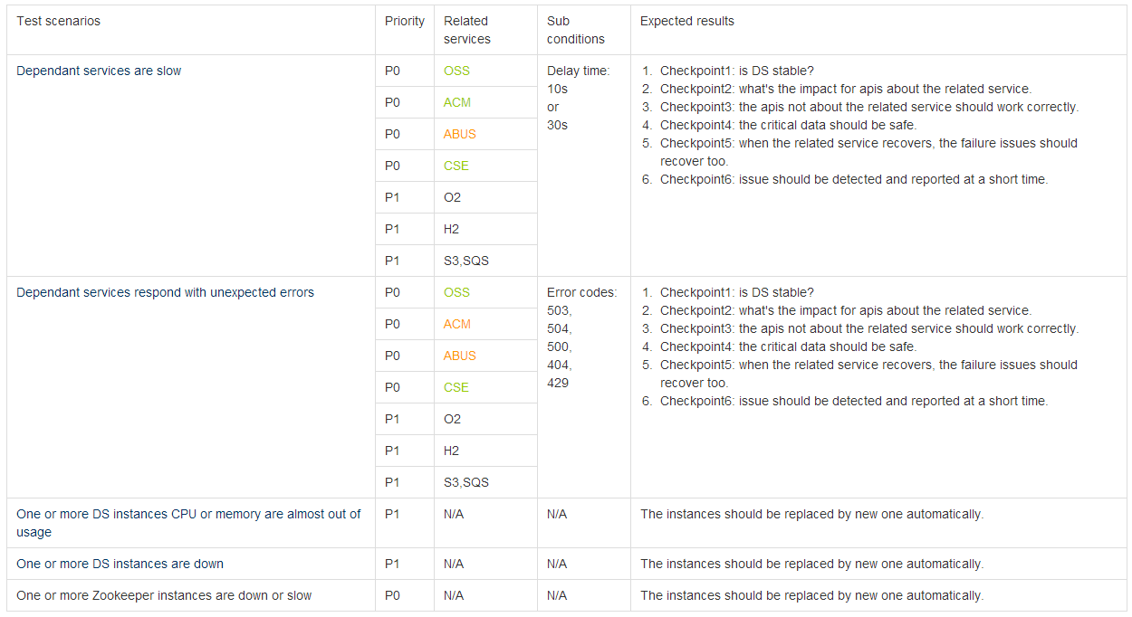
Test Plan
Notes:
From the architecture analysis and code review, we can understand the whole system of DS. We can understand how many services or components will influence it and what its strategies to handle some errors. When I did the test plan, I took a lot of effort to understand DS apis and how they implemented.
With these information , we can write our test plan to conduct us in the big picture.

Slide 14
WireMock
HTTP response stubbing
Request verification
Proxy/intercept
Fault injection
Notes:
To setup the mock server, We use WireMock .
WireMock is a flexIt supports HTTP response stubbing, request verification, proxy/intercept, and fault injection, and it can be used within a unit test or deployed into a test environment.
ible library for stubbing and mocking web services. It works by creating an actual HTTP server that your code under test can connect to as it would be a real web service.

Slide 15
WireMock for Unit Test
public class WiremockDemoTests { @Rule public WireMockRule wireMockRule = new WireMockRule(); @Test public void exampleTest() { wireMockRule.stubFor(get(urlEqualTo("/ds/test")) .willReturn(aResponse() .withStatus(200) .withBody("{\"message\":\"ds resiliency test\"}"))); String url = "http://localhost:8080/ds/test"; String body = "ds resiliency test"; Response response = given().get(url) ; response.then().log().all() ; assertEquals(200, response.getStatusCode()) ; assertEquals(body, response.jsonPath().get("message")); } }
Notes:
This is a Junit test case to leverage WireMock to mock an new api. This is the api endpoint, and these are the expected response code and body. Call the api and then verify the response code and body. When I run the case, it will build a real web service at backend to handle the request. This is just for demo, I believe the real unit case is more complex than this.

Slide 16
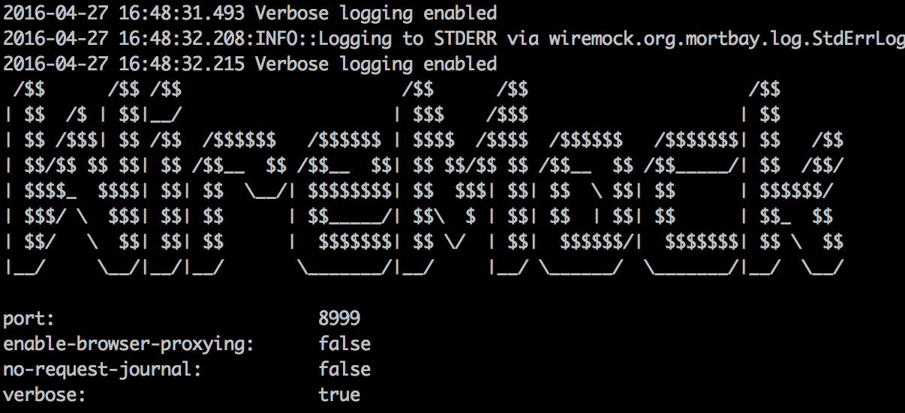
WireMock for Mock Server
java -jar wiremock-1.57-standalone.jar --port 8999 --container-threads 1000 --verbose
Notes:
This is how we use it in resiliency test. What we need to do is run this jar with some parameters. But now It’s an empty service which response for nothing. WireMock is quite easy to use. We can use some json files to define what requests we support and what response we will reply.

Slide 17
WireMock for Mock Server
Example json for delay
{ "request" :
{ "urlPattern" : "/oss/.*",
"method" : "PUT" },
"response" :
{ "status" : 200,
"fixedDelayMilliseconds" : 1000,
"proxyBaseUrl" : "https://developer-dev.api.autodesk.com" }
}
Notes:
Now I can give you two examples to show you how I define my mock service to do resiliency test.
Firstly Let’s see what a request to make some latency look like.
This is used to define which kind of url we accept, it’s a regular expression, all the urls meeting this pattern and the method will be accepted.
If I want to delay the request for 1 second, I set it 1000. After the delay, the request will be sent to this host.

Slide 18
WireMock for Mock Server
Example json for error
{ "request" :
{ "urlPattern" : "/oss/.*",
"method" : "PUT" },
"response" :
{ "status" : 503
}
Notes:
Another example is about error response, it’s very similar to the first one. We just need to change the response status code to the error code we wants.

Slide 19
Fabric
Execute Python functions via command line
Execute shell commands over SSH Pythonic
Notes:
To deploy DS and mock server, I use fabric.
Fabric is a python library and command-line tool for streamlining the use of SSH for application deployment.
It provides a basic suite of operations for executing local or remote shell commands.

Slide 20
Fabric
from fabric.api import local
def test():
local("./manage.py test my_app")
def commit():
local("git add -p && git commit")
def push():
local("git push")
def prepare_deploy():
test()
commit()
push()
Notes:
It’s pretty easy to use, you can execute your shell commands over ssh in a python way. This is a sample. It will execute some git commands in local. Firstly test, then commit the change and finally push the code.

Slide 21
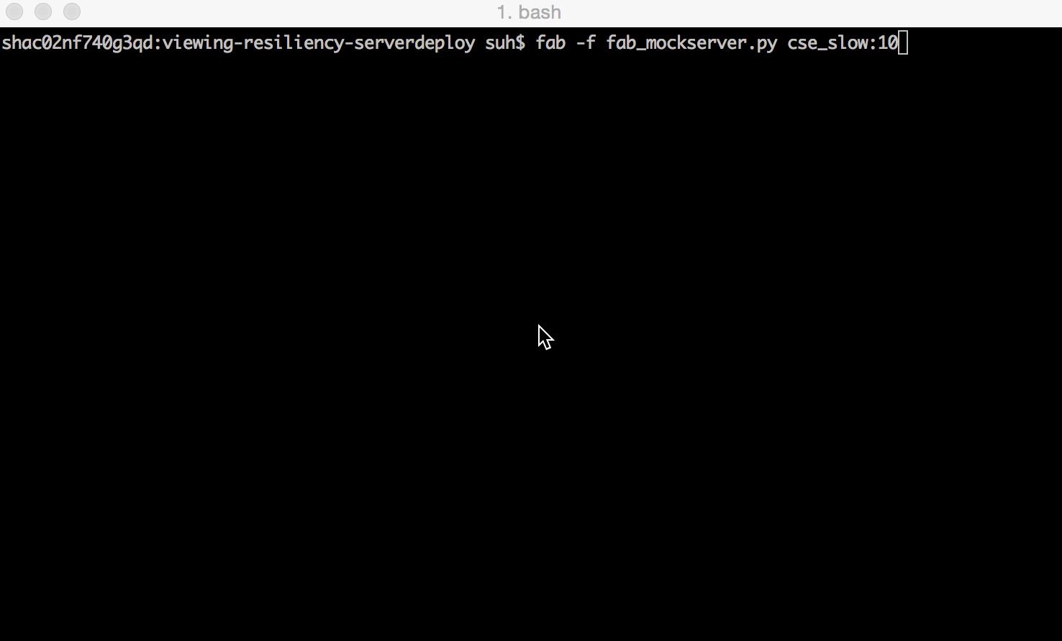
Fabric for Mock Server Deployment
Notes:
This is a simple demo to show how to use fabric to deploy mock server. I just need to run this command, in this case we set all cse requests will be delayed for 10 seconds. Then I check if it is deployed successfully. We can see all the CSE requests will be delayed by 10 seconds.
And this one I set all cse requests will respond 503 error. And check the result again. All the CSE requests from DS will get 503 error.

Slide 22
Test Scenarios
Full api test cases to validate whole status
Specific cases related to dysfunctional service
Run continuously to make sure enough load.
Notes:
For test cases, different service failure has different cases, but they all have same rules.
Firstly we need the full api test cases to check the whole status of the service.
Then we should know which cases will be impacted by the failures, run them to make the service keep touching the dysfunctional service.
At last and the most important thing is to keep running the cases to make sure enough load. When some resources are not exhausted, the service may look good.

Slide 23
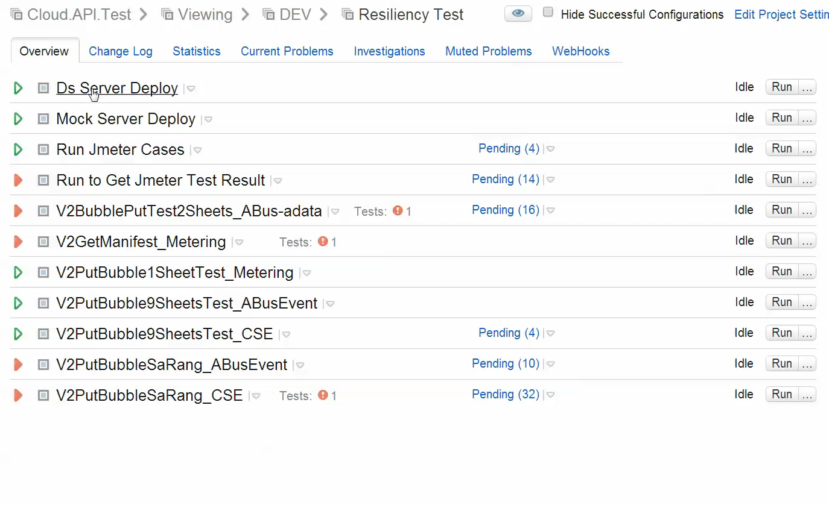
Demo for Whole Automation Pipeline
Notes:
This is the demo of the pipeline. We use teamcity to manage it.
This is the build plan to configure DS server. I can set the DS server host and select the service which will be replaced by our mock server.
This is the build plan to deploy Mock server. Select the service and failure type, and set it value.
The left build plans are all about test cases, different service failure needs different test suites.

Slide 24
Resiliency Test Results Analysis
Notes:
Firstly I will introduce the common checkpoints in resiliency test
Then I will show you the statistics
And finally I will share some improvements we make for DS after the resiliency test.

Slide 25
Verification guideline
Service stability
Impacted & non-impacted APIs
Critical data security and consistency
Service recovers after dependency recovers
Monitoring
Notes:
There are some common checkpoints we should consider in resiliency test.
Is the service stable? Is there some random failure? Will the service crash or out of response?
The impacted apis may fail , but the non-impacted apis should work as normal
The critical data should be safe when the failure of dependent service happens
In most of the cases when the dysfunctional service recovers, the failure cases should recover too.
When some issues happen, they should be detected soon and reported to related people in a short time.

Slide 26
Statistics
Notes:
DS resiliency test help us to find many valuable defects. Some of them are very critical which will cause DS down when the issue really happens in production environment. To do resiliency test, we may not find a lot of defects like functional test, but it will make us feel more confident to deploy the service to production environment. If we don’t do it, these are the potential risk for us and when it happens in production, the influence will be huge.

Slide 27
Derivative Service Improvements
Use buffer and set its proper size
Timeout of the connection
Health page error
Handle exceptions for all possible errors
Notes:
Finally I want to share some improvement in DS after the resiliency test
In most cases, the operations are not in the same pace, it’s better to have buffers to store some data in case the next operation has error and block the whole pipeline or the whole service. But it’s better to give the buffer a sanity size to avoid out of memory thing.
In DS we had a buffer to post CSE events , this is good. But we didn’t set its max size. So when we simulated CSE downgrade, DS crashed after it stored about 800,000 events.
It’s good to set the connection timeout and socket timeout when connecting to the dependent services, taking too much time to wait for connection or response is expensive, it may cause out of resource.
We had some issues about this. One is to validate token from apigee and another is to post events to abus. For the two requests, we didn’t set the socket timeout, if everything is ok, the requests will take less than 1 second. But if there something is wrong, it may take 60s to wait for response. We should set the timeout and have a try if timeout happens.
Be careful to set your health page error, your ELB may use the health page to check the service status, if the health page overreact, a small error may cause the whole service unavailable.
When ZooKeeper cluster was down, DS health page has a small issue, but according to DS ELB criteria, it thought DS was unhealthy, so all the request got 503.
Don’t just handle the errors written in the wiki, sometimes the dependent services may respond the unexpected error codes and body which we also should handle.
In the production environment, someday O2 return a 502 error with an html body. But this is not written is its wiki. So DS assume all the body will be a json and use a json library to parse the body, and of course some exception was thrown out.

Slide 28
Derivative Service Improvements(Cont.)
Push back data when errors happen
Retry mechanism
Connection pool leak
Record enough logs for errors or latency
Notes:
For some critical data, it’s better to push it back when the dependency respond error.
In DS we push the manifest messages to SQS to merge manifest, when OSS was down, DS cannot download the manifest from OSS. But it didn’t push the message back which would cause all registration jobs failed.
Retry is good, it makes the service more reliable, because we never know when the dependencies will respond an error. But sometimes retry may bring more unnecessary to dependencies especially when they really have some issues. In DS now if it encounters some dependent server error, it will try again. Actually I think We could do better, like if it receives 429, it will not retry, if it always receives 500 error or takes long time to get response, it will not retry too. Because that means the dependent service has real trouble now. To have a retry will not increase the success rate.
Connection pool leak may cause the whole service out of connection.
We ever had one issue about connection pool leak, this issue caused DS unavailable when load test run for a while.
Enough logs for errors or latency are critical for us to locate the issues. So it’s better to record the response errors and time when calling the dependent services.
DS has some monitor tools to monitor instant server load, error rate, error type distribution, dependent services status, CPU/MEM/DISK/SQS etc. In splunk log, we also record the error messages and the round-trip time when call other services.

Slide 29
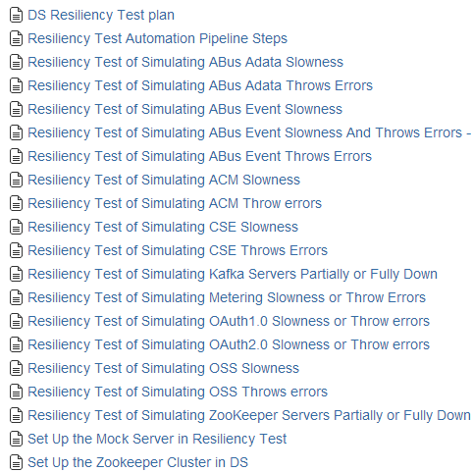
Reference
https://wiki.autodesk.com/display/saascore/DS+Resiliency+Test
http://wiremock.org/
http://www.fabfile.org/
Emails:
Christy.Gu@autodesk.com
Hang.Su@autodesk.com

